Slide 4
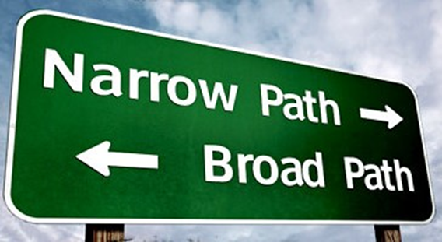
Sermon on the Mount
Matthew 5-7
“The Difficult And Easy Ways”
Matthew 7:13,14

Slide 5
There Are
NO ALTERNATIVES
IF You Do NOT Choose the
NARROW GATE And the
DIFFICULT WAY-
You Have Chosen the
WIDE GATE and BROAD WAY
That leads to DESTRUCTION!

Slide 6
Sermon
on
the Mount
THE EASY WAY OF THE MANY
“Gate” – opening or entrance into the “way”
“Wide gate” – method of entrance to “broad way” which “many” are traveling.
“Wide gate” – large, hard to miss!
  Inviting – appeals to those who don’t want to put out too much effort
  Alluring to the flesh – seems to offer pleasures and comforts

Slide 7
Sermon
on
the Mount
THE EASY WAY OF THE MANY
“Wide gate” – large, hard to miss!
  Place reserved for Satan and all who follow him- Matthew 25:41
  Entrance is Easy- “Many who go in by it.”
  “Broad Way” used to describe the life that is lived – Lifestyle

Slide 8
Sermon
on
the Mount
WHAT IDENTIFIES THE “BROAD WAY?”
It leads to destruction
It is Easy
It is filled with all forms of error
It is living purely a natural life
It is presented as the life of freedom and self fulfillment
It is viewed as the life of pure enjoyment

Slide 9
Sermon
on
the Mount
THOSE TRAVELING THE “BROAD WAY”:
Sin by not serving Jesus
Do Anything or nothing at all
Advocate freedom of expression
Advocate sexual liberty
Fleshly Liberty – that which gratifies flesh
  Bar rooms and dance halls
No obligation to others

Slide 10
Sermon
on
the Mount
THE HIDDEN TRAP OF THE “BROAD WAY”
Liberty felt and embraced – captivity actually taking place - John 8:34
Peter says of them: 2 Peter 2:18,19
THE END OF THIS WAY IS DESTRUCTION
2 Thessalonians 1:8,9 “…taking vengeance on those who do not know God, and on those who do not obey the gospel of our Lord Jesus Christ. 9…punished with everlasting destruction…”

Slide 11
Sermon
on
the Mount
THE DIFFICULT WAY OF THE FEW
The “NARROW GATE” is:
Not “straight” but rather it is restricted
Separated from the common course
More Challenging – takes conscious effort – Can’t just stumble into it!
Jesus is the door keeper – John 10:9 “I am the door. If anyone enters by Me, he will be saved, and will go in and out and find pasture.”

Slide 12
Sermon
on
the Mount
THE DIFFICULT WAY OF THE FEW
Interesting Note:
Jesus make no excuses for the terms to enter the “narrow gate”
He does not leave us expecting an easy life
It this sermon He has marked “way of life” by difficult and demanding requirements
Must be impressed with His truthfulness
Does not say, “Just ease on in, the water is fine”

Slide 13
Sermon
on
the Mount
THE DIFFICULT WAY OF THE FEW
Luke 13:24 NKJV 24 "Strive to enter through the narrow gate, for many, I say to you, will seek to enter and will not be able.”
Jesus says here “Many” will try to enter and not be able!
Why won’t the be able to enter?
They will not be willing to have the determination and to truly struggle to enter!

Slide 14
Sermon
on
the Mount
THE DIFFICULT WAY OF THE FEW
“Difficult” -
Root word “press, crush, rub, push”
Matthew 7:14 “squeeze together, i.e. narrow”
W. E. Vine “hemmed in, like a mountain gorge; the way is rendered “narrow” by the divine conditions, which make it impossible for any to enter who think the entrance depends upon self-merit, or who still incline towards sin, or desire to continue in evil.”

Slide 15
Sermon
on
the Mount
WHAT DEFINES THE DIFFICULT WAY?
It leads to Life – 2 Timothy 4:8
John 6:44 “I will raise him up at the last day.”
It is the Opposite of the way traveled by those aimlessly drifting through life
Its Difficulty
Great effort is required
Romans 6:18 “And having been set free from sin, you became slaves of righteousness.”
2 Timothy 3:12 “all who desire to live godly in Christ Jesus will suffer persecution.”

Slide 16
Sermon
on
the Mount
HELP ALONG THE “DIFFICULT WAY”
THE END OF THIS DIFFICULT WAY IS LIFE
WHO IS ON THE “BROAD WAY?”
WHO IS ON THE “DIFFICULT WAY?”
WHO CARES?
Jesus does!
Matthew 7:13 "Enter by the narrow gate; for wide is the gate and broad is the way that leads to destruction, and there are many who go in by it.”

